Slide 1
Practical III
Nonlinear Optimisation in 2-D

Slide 2
1.
The model problem
Analytical test functions in 2-D

Slide 3
Test functions
No-free-lunch theorem
There is no such thing as a universally superior method.
Efficiency rests in the application of a method to a specific problem (problem adaptation).

Slide 4
Test functions
No-free-lunch theorem
There is no such thing as a universally superior method.
Efficiency rests in the application of a method to a specific problem (problem adaptation).
→ Optimisation methods are typically applied to more or less pathological test functions in order to study their behaviour for certain classes of problems.

Slide 5
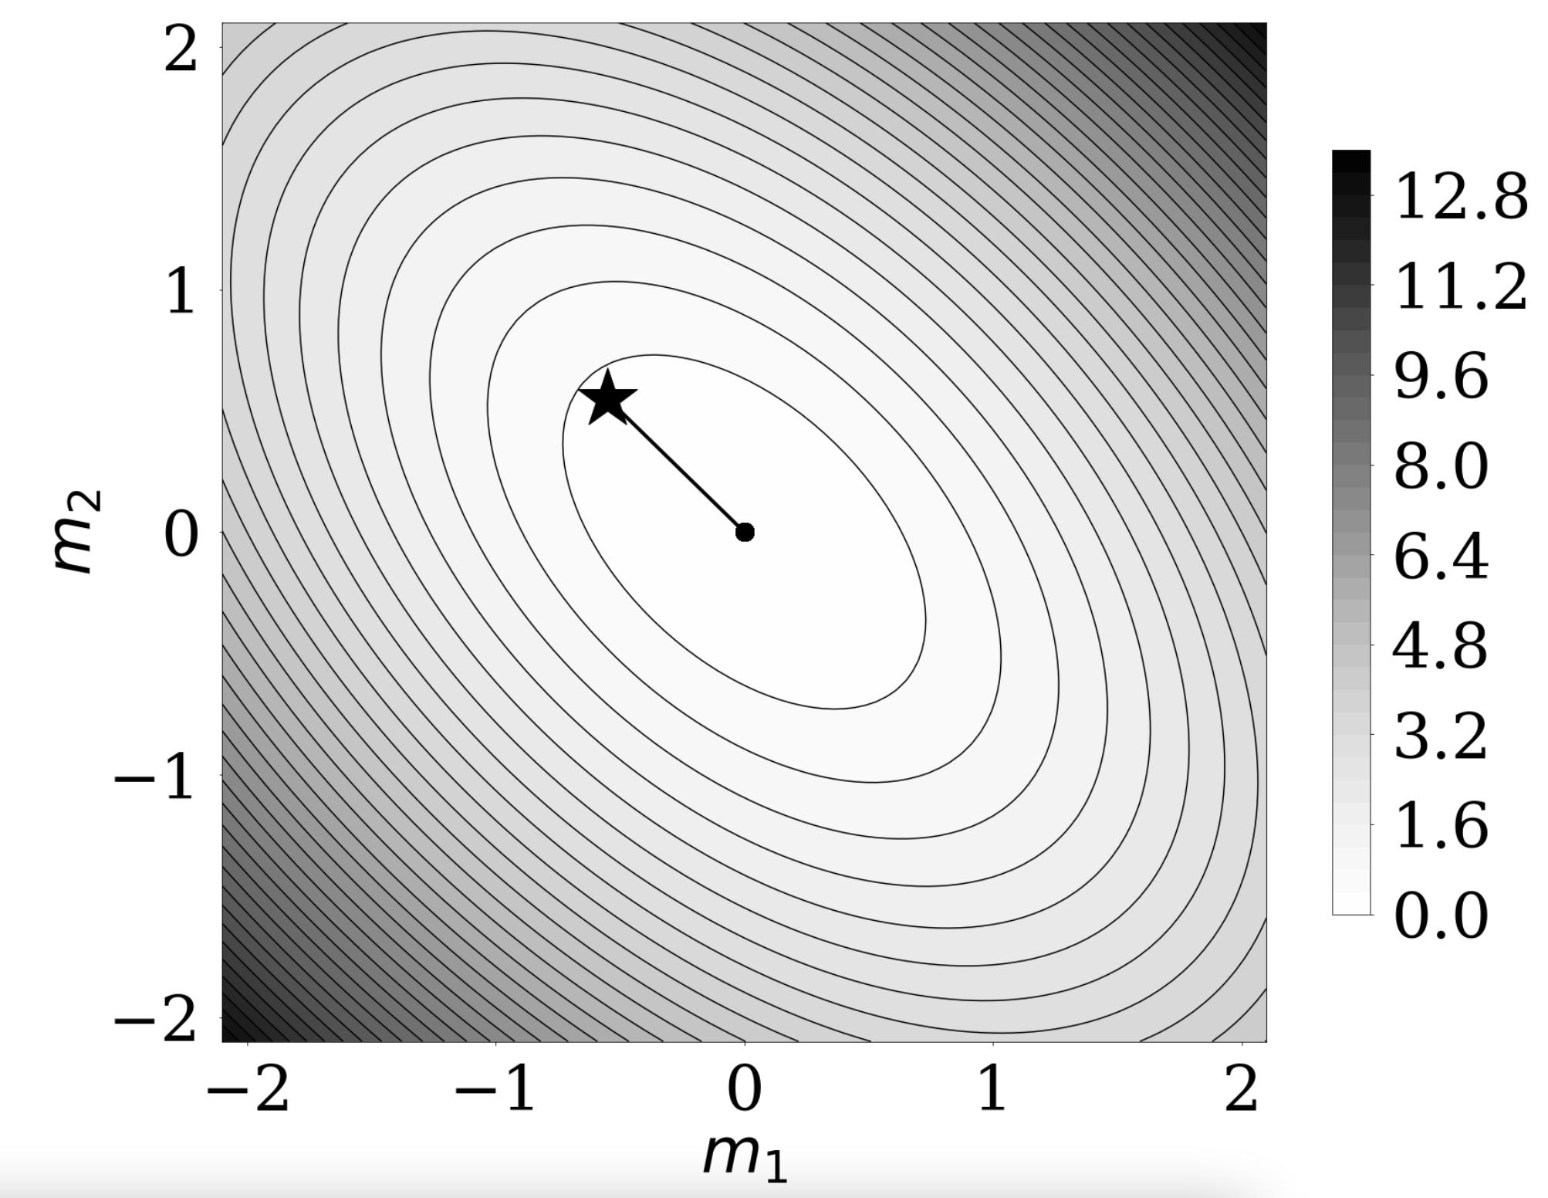

Rosenbrock function
quadratic function

Slide 6
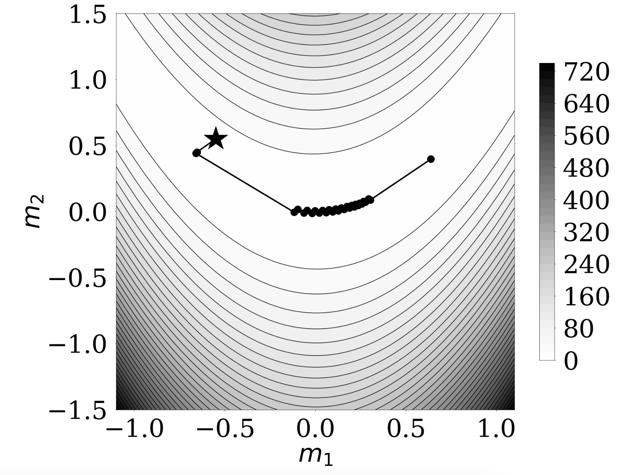

Rosenbrock function
Rosenbrock function

Slide 7
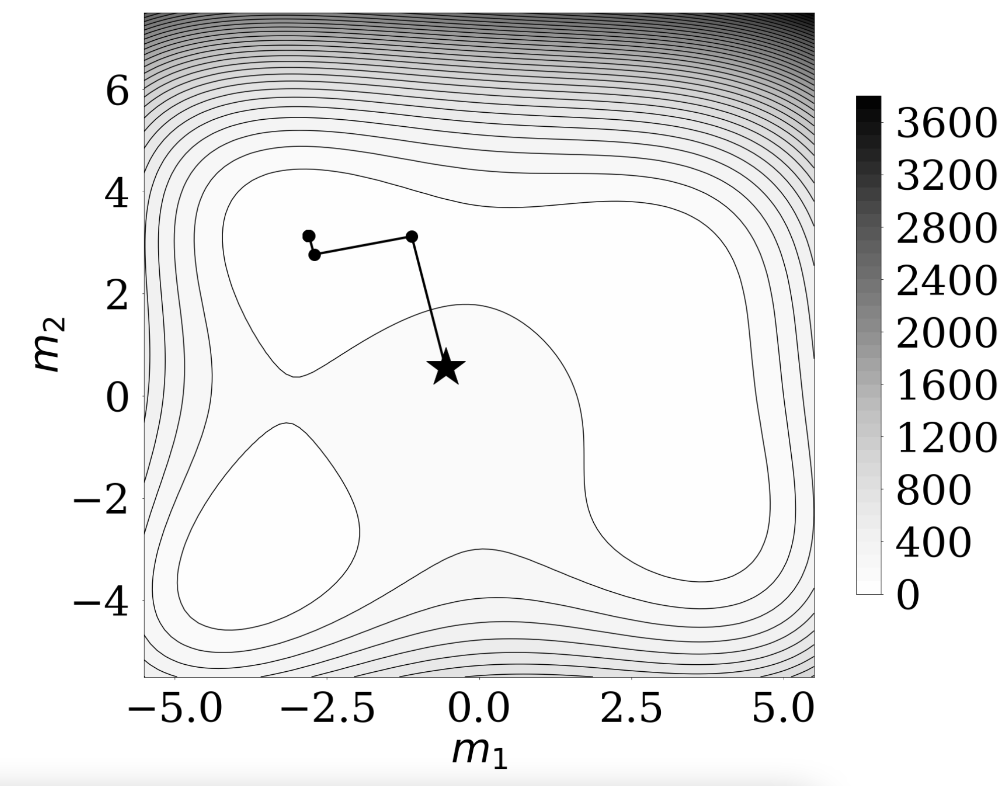
Rosenbrock function
Himmelblau function

Slide 8
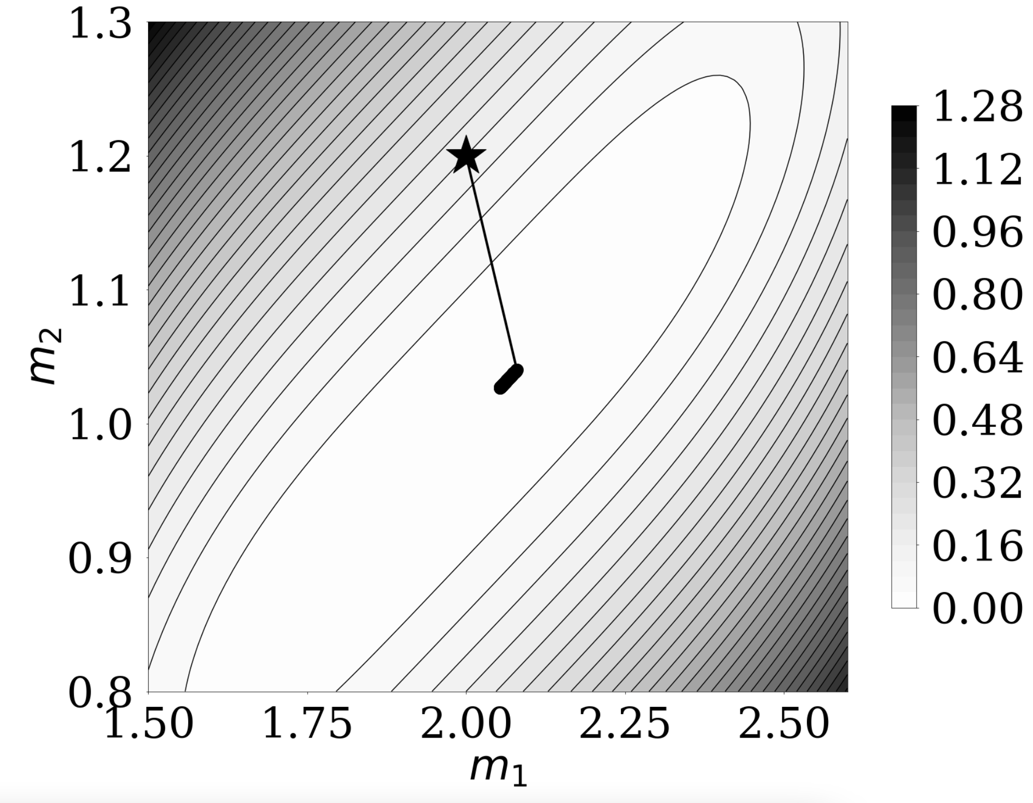

Rosenbrock function
Bazaraa-Shetty function

Slide 9
2.
Jupyter notebook

